Slide 1
ENGR 12
Dr. Mandala
Notes:
Down

Slide 2
Functions summary
A function can receive and send no value
void foo(void)
If a function sends a value, you need a return statement.
When a return statement in a function is executed, the function stops and returns value back
int foo(void){int a=100; return a; a = 12;}
value sent should match data type declared on left of the function definition.
int foo(void) should return an integer
char foo(void) should return a character
Declare datatypes of all input arguments in function
int foo(int a, int b, char c, double d);
foo accepts four variables
a and b are type INT
c is type CHAR and d is type DOUBLE

Slide 3
Pointers
What happens when you declare a variable?
int age = 20;
The runtime code:
Randomly finds an unused memory location of fixed size (say, 2 bytes for int, 4 bytes for long int) given by some address. Ex: 00x1344FA120
Associates this address (00x1344FA120) with variable name (age) given.
Assigns value 20 to this address/name.
What is the scope (accessibility) of this variable, age?
Depends on location of declaration.
If within function, this address/variable is accessible within the function (local).
If declared outside any function, this address variable is accessible everywhere (global).

Slide 4
Definitions (memorize)
int age = 12;
assigns value 12 to variable age at some randomly chosen location in memory
&age
read as address of age
displays the variable memory address or location
Can you store this address in another variable?
Yes – requires a special variable type called Pointer Variable
Pointer variable points to the address of another variable.

Slide 5
Pointers Example
Select address: 0x7ffeefbff5dc and assign name age to address. Assign value 12 to age.
int age = 12;
int *add_age;
add_age = &age;
How can you view value stored at address held in add_age?
Create a pointer variable to hold address (point to an int).
This variable also requires memory location assigned to it to hold the address value.
Select address: 0x7ffeefbff5d0 and assign name add_age to address
Assign address of age: 0x7ffeefbff5dc as a value to variable add_age

Slide 6
Definitions (memorize)
Syntax | Description
[data type] age int age=12; float age=12.0; char age=‘A’; | Variable name, holds a value as defined by data type
&age | Address of variable age, holds an address value.
int *address_age; address_age = &age; | Pointer variable name, holds an address Points to datatype defined.
*address_age | Points to value held in address held at address_age

Slide 7
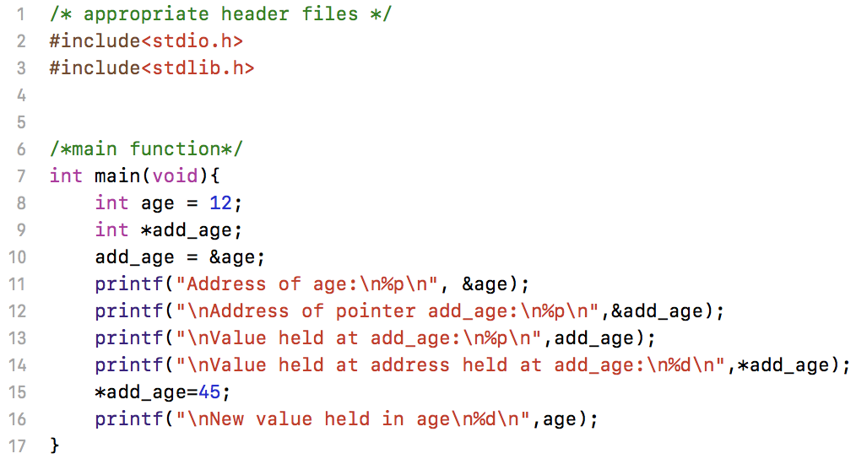
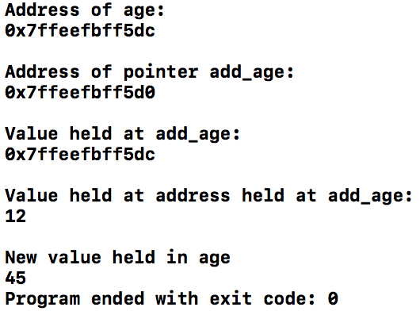
Sample pointers

Slide 8
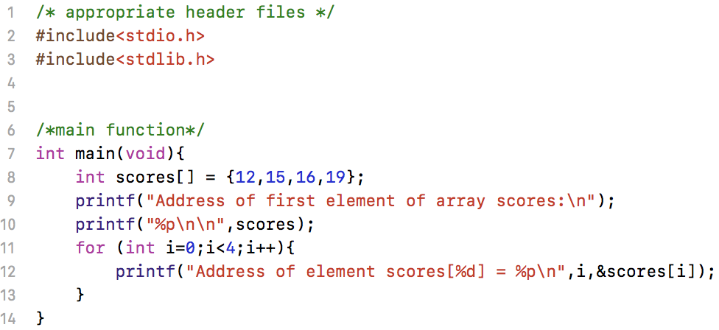
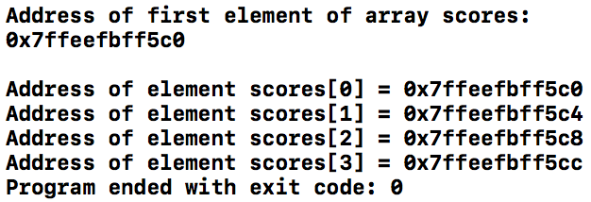
Arrays: a special pointer type

Slide 9
Quick Summary on Arrays
Strings are character array
char name[20]=”Jon”
is stored as
name[0] = ‘J’
name[1] = ‘o’
name[2] = ‘n’
name[3] = ’\0’
The empty character ‘\0’ helps identify the end of a character string.
In general, the runtime code may not know where the end point of an array is, except for strings as mentioned above.

Slide 10
How does it work?
int scores[2]={12,15};
Runtime code:
Randomly selects a memory address location, say: 0x7ffeefbff5d0, and assigns name scores to it.
In fact, this memory address contains the first element of scores, i.e., scores[0]
scores[1] is held at address adjacent to address holding scores[0]
Address (pointer) | 0x7ffeefbff5d0 | 0x7ffeefbff5d0 | 0x7ffeefbff5d4 | 0x7ffeefbff5d8
Address (decimal) | 4022334928 | 4022334928 | 4022334932 | 4022334936
Name | scores | scores[0] | scores[1] | scores[2]
Value | Undefined | 12 | 15 | Undefined

Slide 11
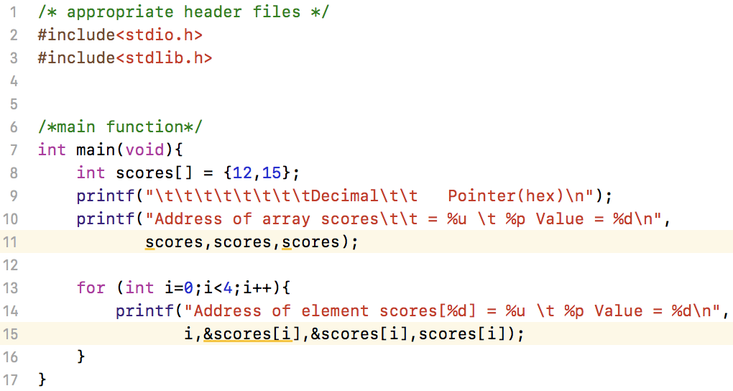
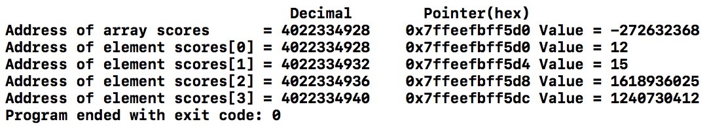
Array pointers
Why does the same address return different values?
Notes:
scores contains address of first element of array scores, i.e. scores[0]
To view value stored at this address type:
scores[0] or
*scores

Slide 12
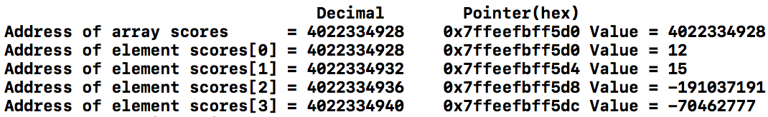
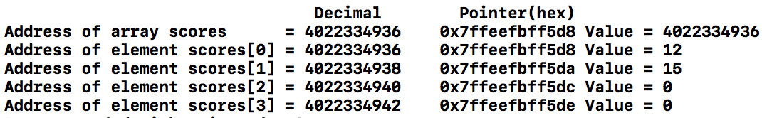
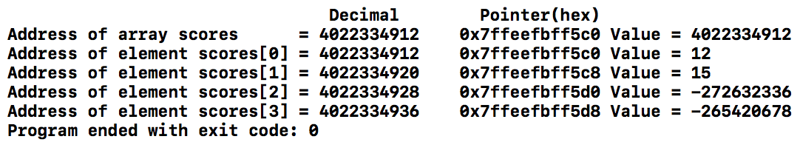
Closer look at array address
int scores[2]={12,15};
short int scores[2]={12,15};
long int scores[2]={12,15};
Notes:
Each address location contains 1 byte of data or 8 bits (0 or 1): Example 0 0 0 0 0 0 0 0
int is 4 bytes
short int is 2 bytes
long int is 8 bytes

Slide 13
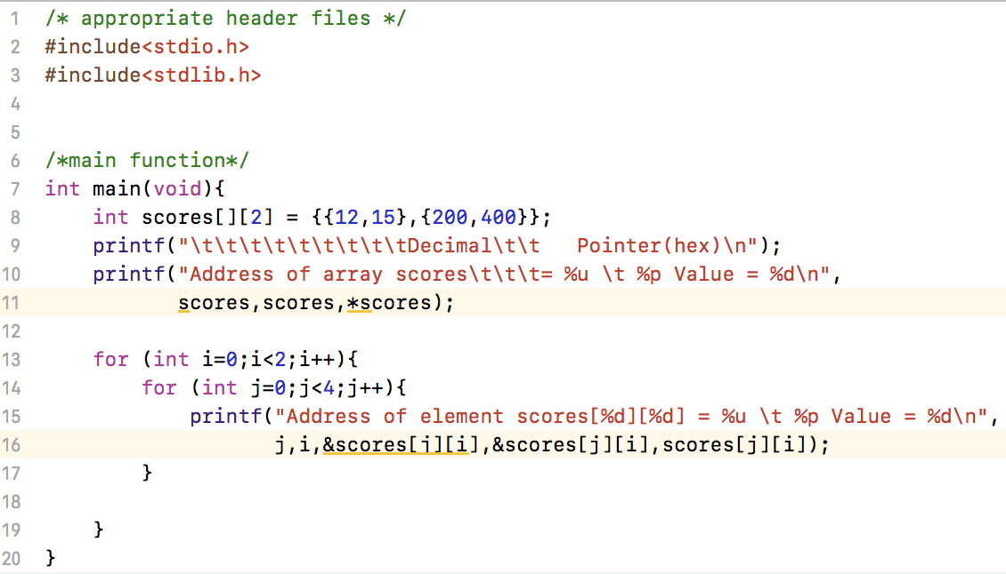
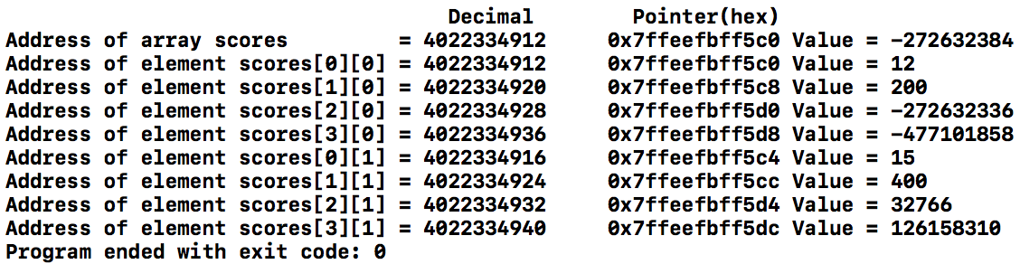
What about multi dim array?

Slide 14
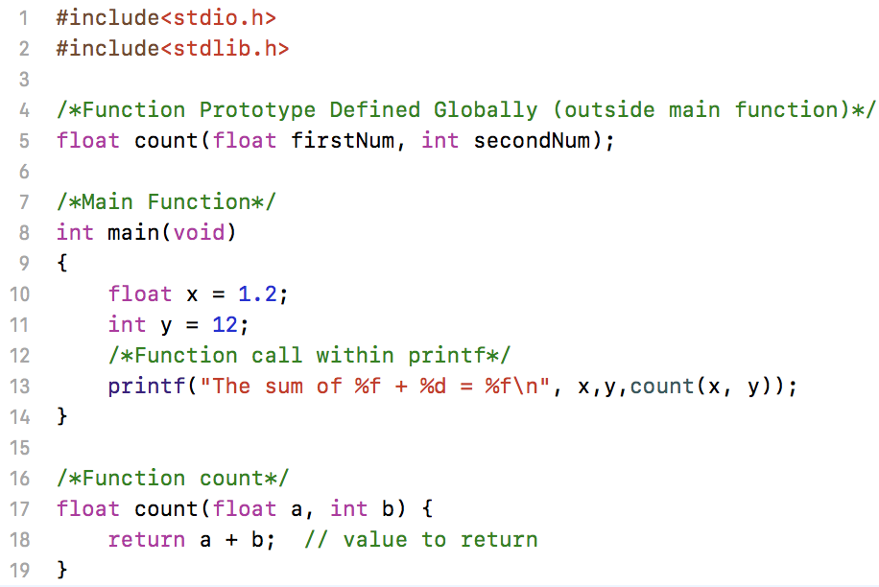

Functions
Function definition: Lets compiler know that a function of this syntax exists to set rules for its use.
Variable names are optional in definition, their types are not.
float count(float, int);
Function calls can be made within scope of the function definition. Here function was defined outside of main(): it is a global function i.e. any code written in this file can access it!
Function declaration should contain the variables to be used within it.
return command returns the value back to its caller.

Slide 15
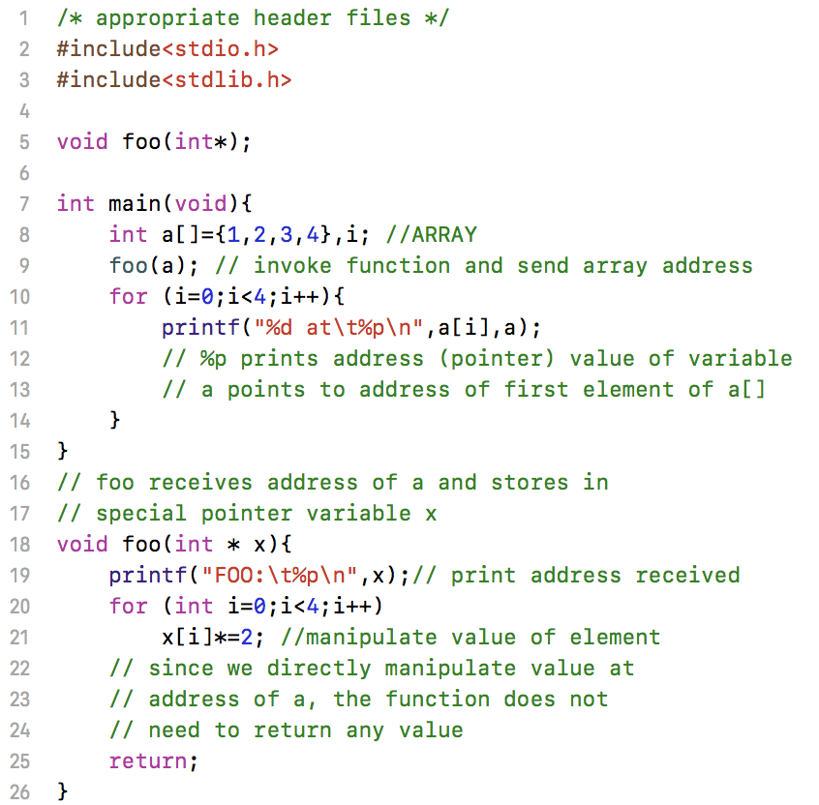

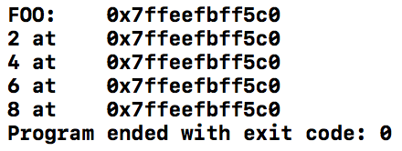
Sending 1-d array to function
Since array’s are special type of address variables or pointers, you can send the address of the array to function
In function prototype, define input argument to be a pointer. Alternatively
Send address of array a
Receive address of array and save in x
NOTE: No return needed as we manipulate values at original address

Slide 16
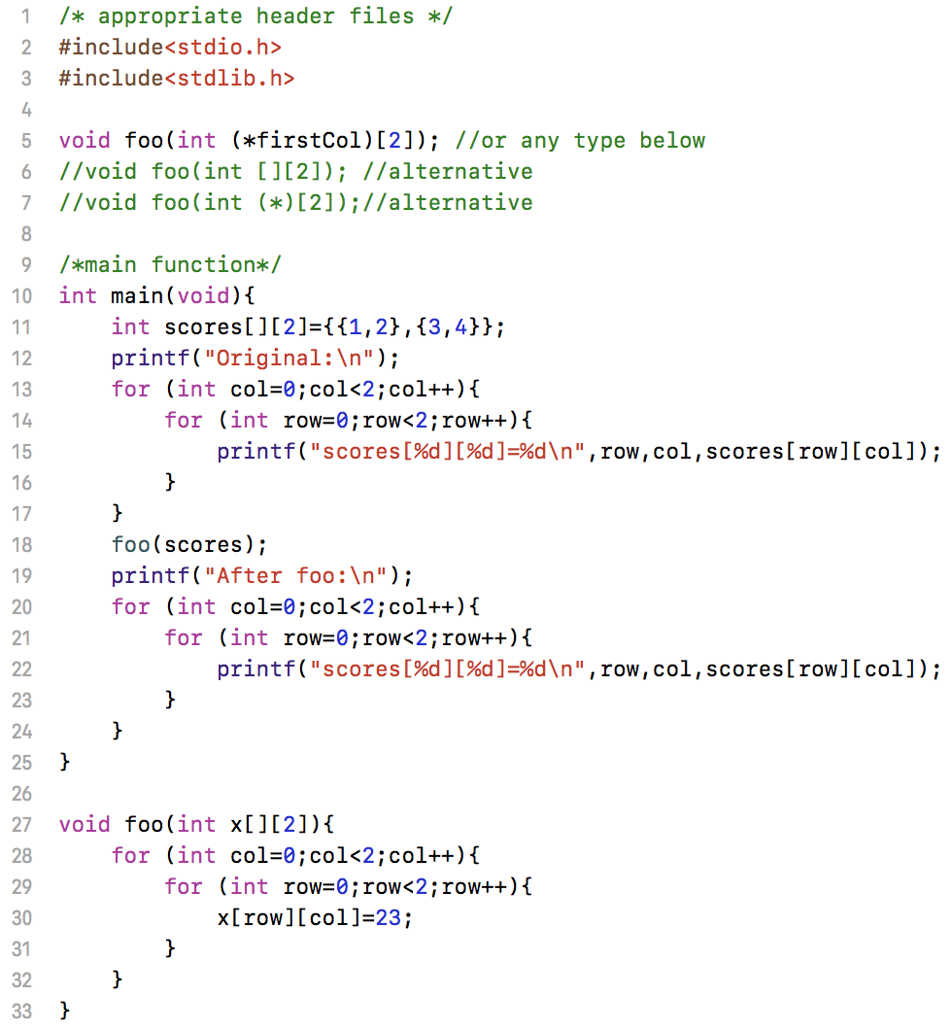
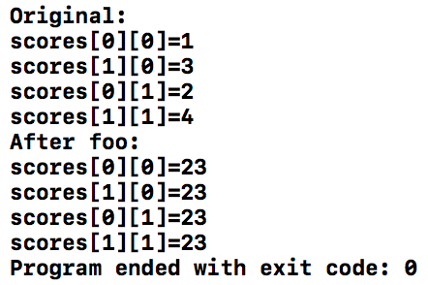
Sending 2-d array to function
Must indicate number of non-first dimension in both prototype and definition
Send the address of array

Slide 17
Summary
Expression | Description
int *a float *b char *c | Pointer declaration. Pointer variables point to respective datatypes. [Can only hold address of specified data type]
int a[20] double b[20] char name[20] | a, b, and name point to the address of a[0], b[0], and name[0] respectively.
*a *b *c | Point to value held at address
&age &name &score | Address of corresponding variable

Slide 18
Send by value & address
Which of the following function calls sends information to function as a value or address?
int average, scores[20];
average = meancalc(scores);
average = meancalc(scores[0]);
average = meancalc(&scores[2]);

Slide 19
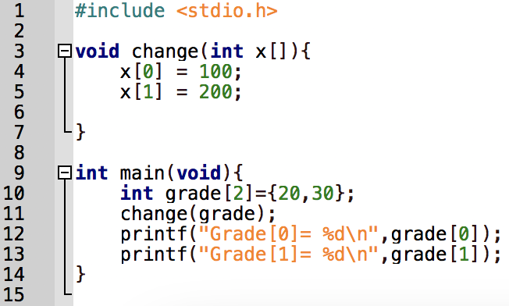

Send by value and address
When you send by value to a function
The value used is local within the function. It is not automatically returned to the point where the function was called from (usually from MAIN function).
Only exception, when the value is stored in a global variable.
When you send by address to a function
Any modification of values at given address is available to the function that sent these values.

Slide 20
As a team:
Write a C code that:
Create float array in MAIN()
Use a function “uservalue” to accept user entered real number values and save them in the two indices of the float array
Swap the values of first and second element of array using function “swapper”
Print the following formatted characters before and after swap:
a = %0.3f and b = %0.3f
uservalue function:
Ask user to enter a real value between 0 and 10
Error check and return value
swapper function:
Accepts address of array of two elements
Swaps values in array
NOTE: You may need to create other variables as needed.

